Slide 1

Introduction to Presentation
બેઝિક પ્રેઝન્ટેશન
CSR Initiative of Tata Power & Sai’s Angel Foundation, Vadodara
Notes:
પ્રેઝન્ટેશન

Slide 2

Home Menu
Clipboard & Slides

Slide 3
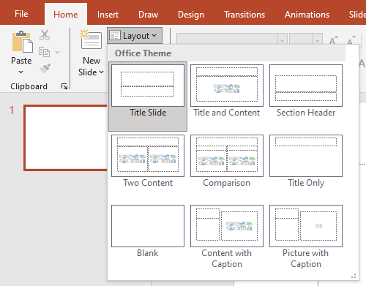

Slide 4
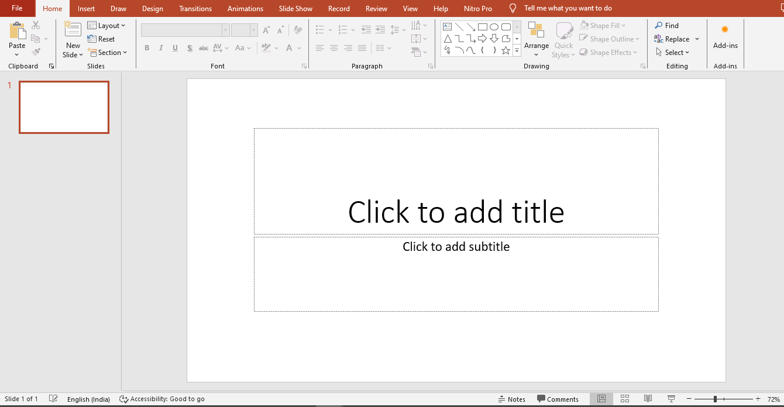

Slide 5
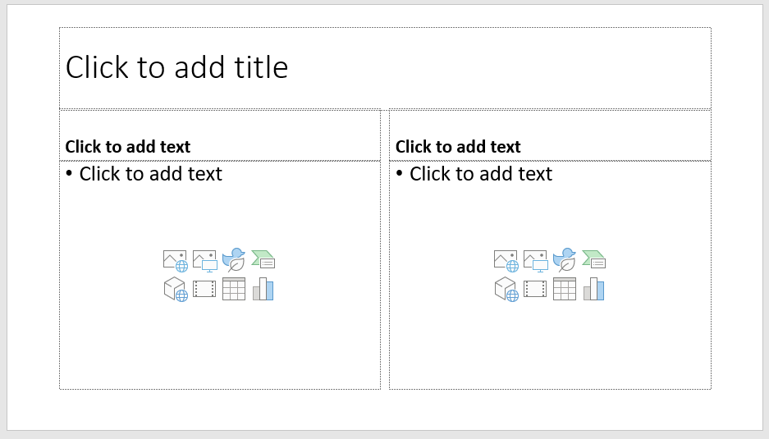

Slide 6
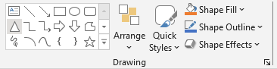
Home Menu
Drawing Tools

Slide 7
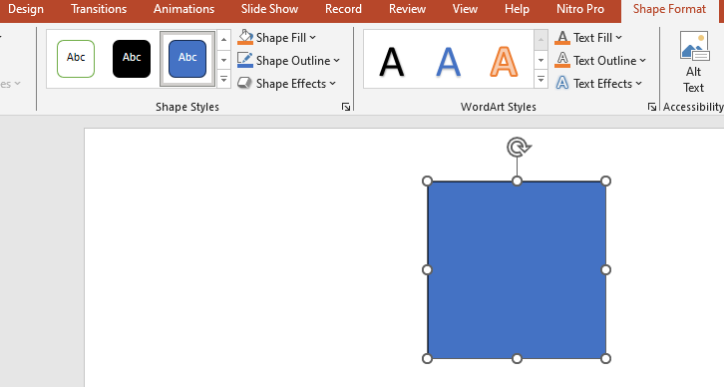

Slide 8
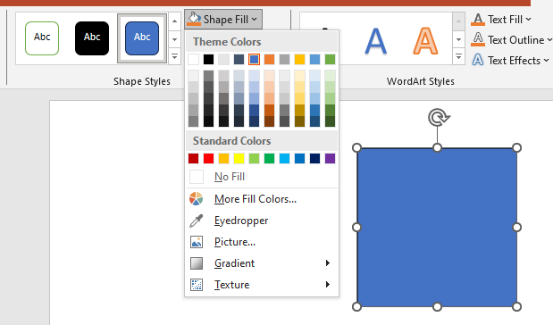

Slide 9

Home Menu
Fonts & Formatting

Slide 10
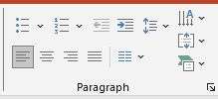
Home Menu
Formatting Paragraph

Slide 11
Hello, I am YOUR NAME, currently in the 8th grade, and residing near Mandvi, situated in the Kutch district.
My village is called YOUR VILLAGE.
I am excited to embark on a journey to explore basic computer skills through the Digital Literacy Program offered by the Sai Angel Foundation, with generous support from Tata Power's CSR initiative.
I Am Truly Grateful For This Opportunity.

Slide 12

Insert Menu
Images, Videos, Shapes

Slide 13
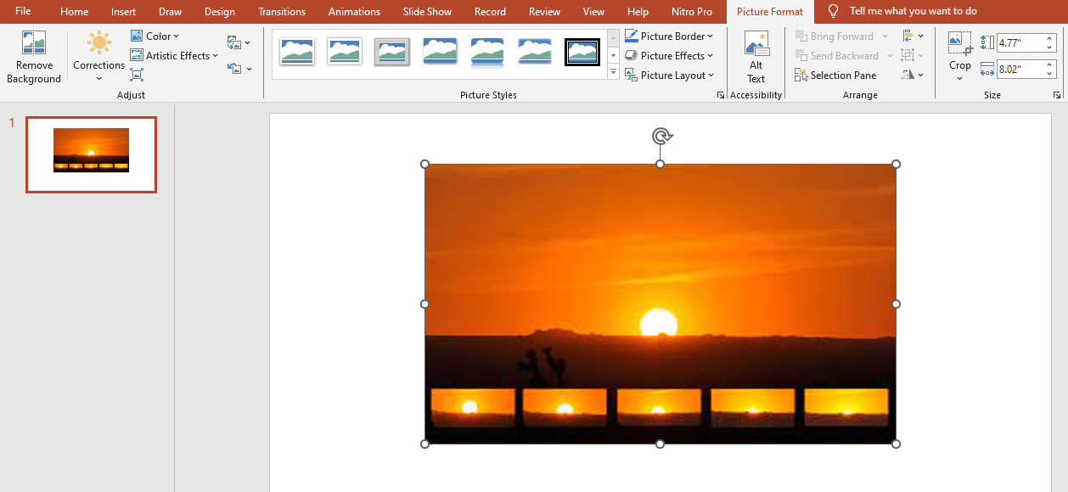

Slide 14

બેઝિક સર્કિટ એક્ટિવિટીમાં કોઈ જગ્યાએ કંઈ ન સમજાયું હોય
હાથ ઉપર કરો અને પૂછો
Notes:
હાથ ઉપર કરો અને પૂછો

